Slide 1
CIFAR-100 Image Classification Web App
Real-Time Image Classification using Deep Learning
By George Sylva

Slide 2
Project Overview
Key Points:
Objective: Build an interactive web app for image classification.
Dataset: CIFAR-100 (100 object categories, 60,000 images).
Technology Stack:
Frontend: Streamlit
Backend: TensorFlow, Keras
Deployment: Streamlit (cloud).

Slide 3
Methodology
Key Steps:
Dataset Preparation:
CIFAR-100 images size checked to be 32x32 pixels.
Normalized pixel values to scale [0, 1].
Data Augmentation to increase dataset size for enhanced model performance
Model Selection:
Pre-trained CNN using Resnet50.
Web App Workflow:
Upload → Preprocess → Predict → Display Results.

Slide 4
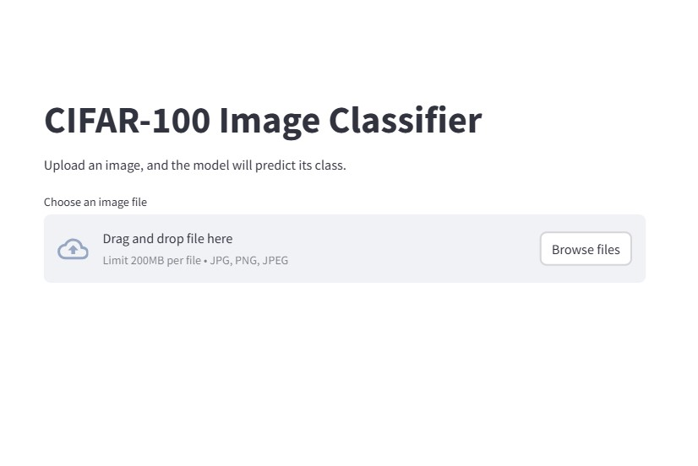
Visual of UI

Slide 5
Application Architecture
Input image
Neural network
Preprocessing
Output prediction and confidence score
Architecture Highlights:
Frontend: User uploads an image, UI displays results.
Backend: Model predicts class using TensorFlow.

Slide 6


Model Performance
Performance of using the resnet50
Model comparison with classical models

Slide 7
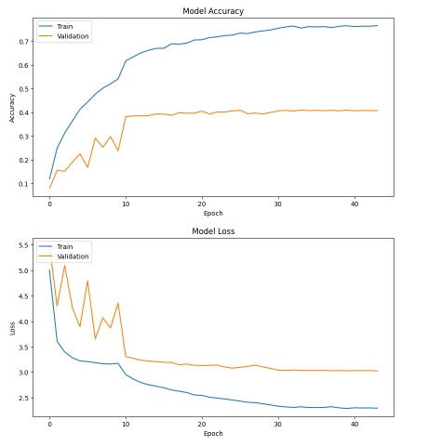
Model Performance
The accuracy and Loss plot showed that the model had a training accuracy of up to 76% and a validation accuracy of about 41%. This was after attempts to reduce the model overfitting results from a training accuracy of 89% while validation was at 43%

Slide 8
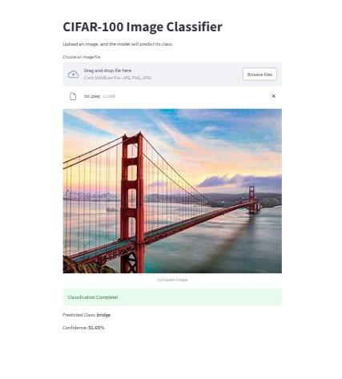
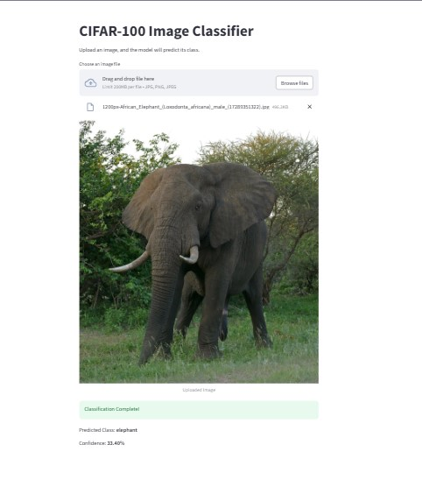
Results on new images after deployment Some rightly classified images

Slide 9
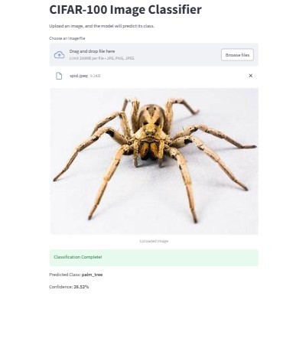
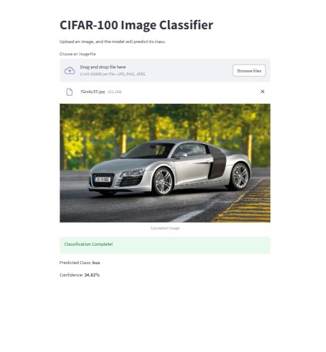
Results on new images after deployment Some wrongly classified images

Slide 10
Findings
Summary of Results:
Model was able to classify CIFAR-100 images in real-time.
Confidence scores were consistent with predictions.
Challenges:
Difficulty handling unseen or noisy images.
Limited augmentation can be done due to image dimension
Limited interpretability of certain predictions.

Slide 11
Recommendations
Short-Term Goals:
Add preprocessing for non-CIFAR images, this includes the addition of new images.
Test out the model on CIFAR-10 to see how well it performs
Long-Term Goals:
Experiment with other ResNet variant as well as other CNNs.

Slide 12
Conclusion
Summary:
I built a working CIFAR-100 classifier using a CNN and Streamlit web app.
I demonstrated how AI/ML models can be integrated into user-friendly applications.
Next Steps:
I will look at enhancing model robustness on current dataset.
I will aim to expand the app feature for an even better user experience.

Slide 13
Thank You

